Slide 1
MLB Postseason Roster Web Application
Matt Gates, Tanner Graham, Cade McPartlin

Slide 2
Table of Contents
MongoDB (Database)
Flask (API)
Bootstrap (GUI)
Application Examples

Slide 3
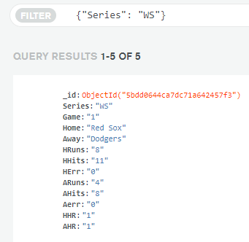
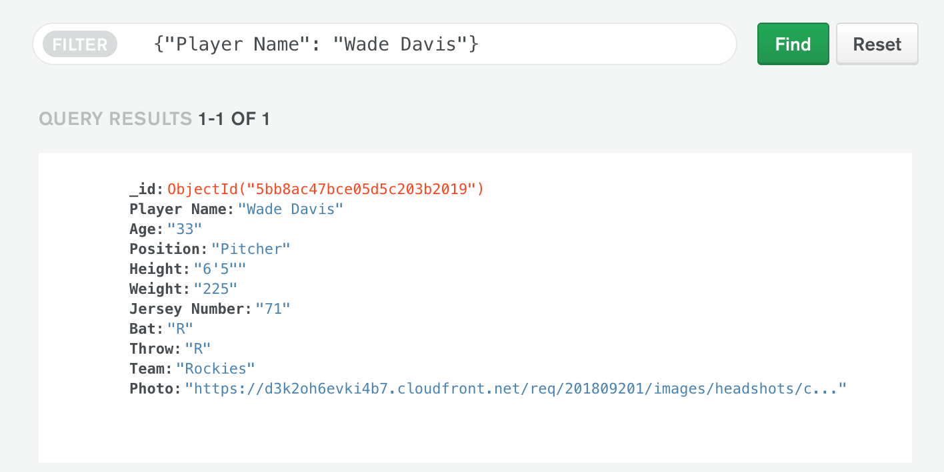
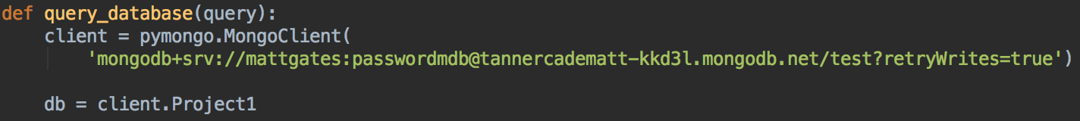
MongoDB Atlas

Slide 4


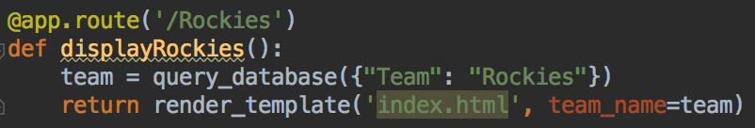
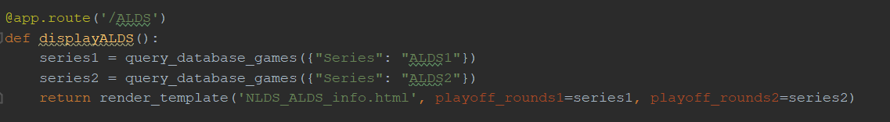
Python
Flask for creation of application routes
Pymongo for connection to database
Query information from database
Pass list of each team to Flask route

Slide 5

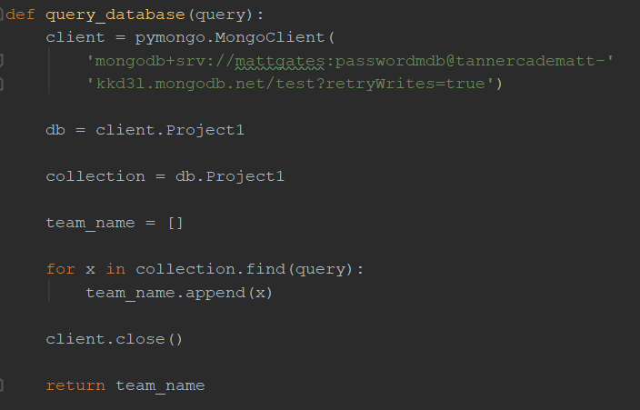

Python cont.
Database Query

Slide 6
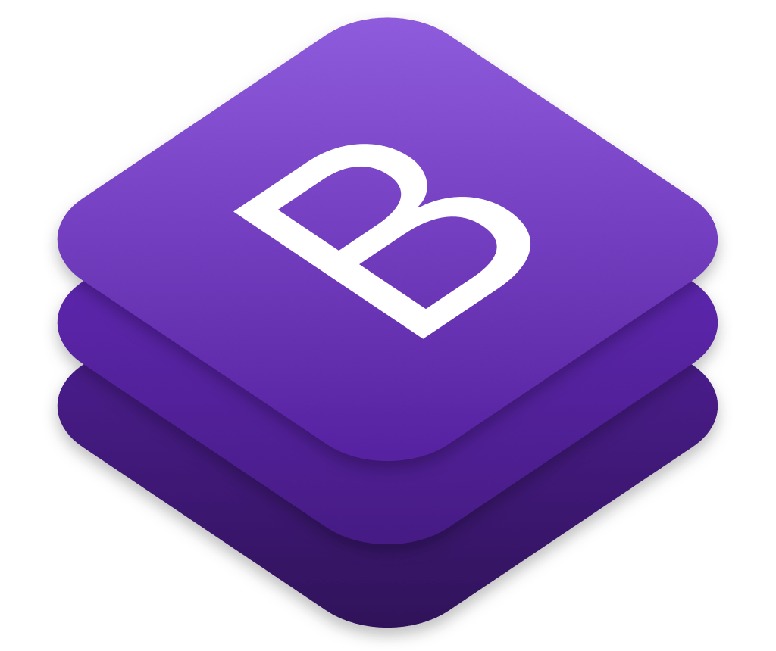
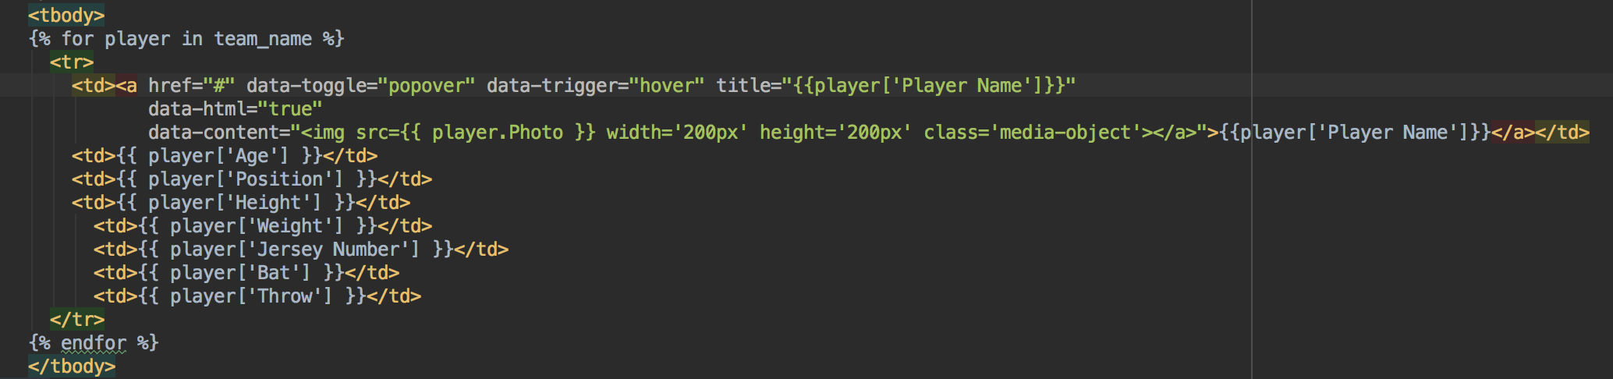
Bootstrap GUI
Bootstrap for major UI design
Jinja to dynamically generate information from database
Jinja - template engine for Python; Flask implements it
JavaScript for popover feature

Slide 7
GUI Examples

Slide 8
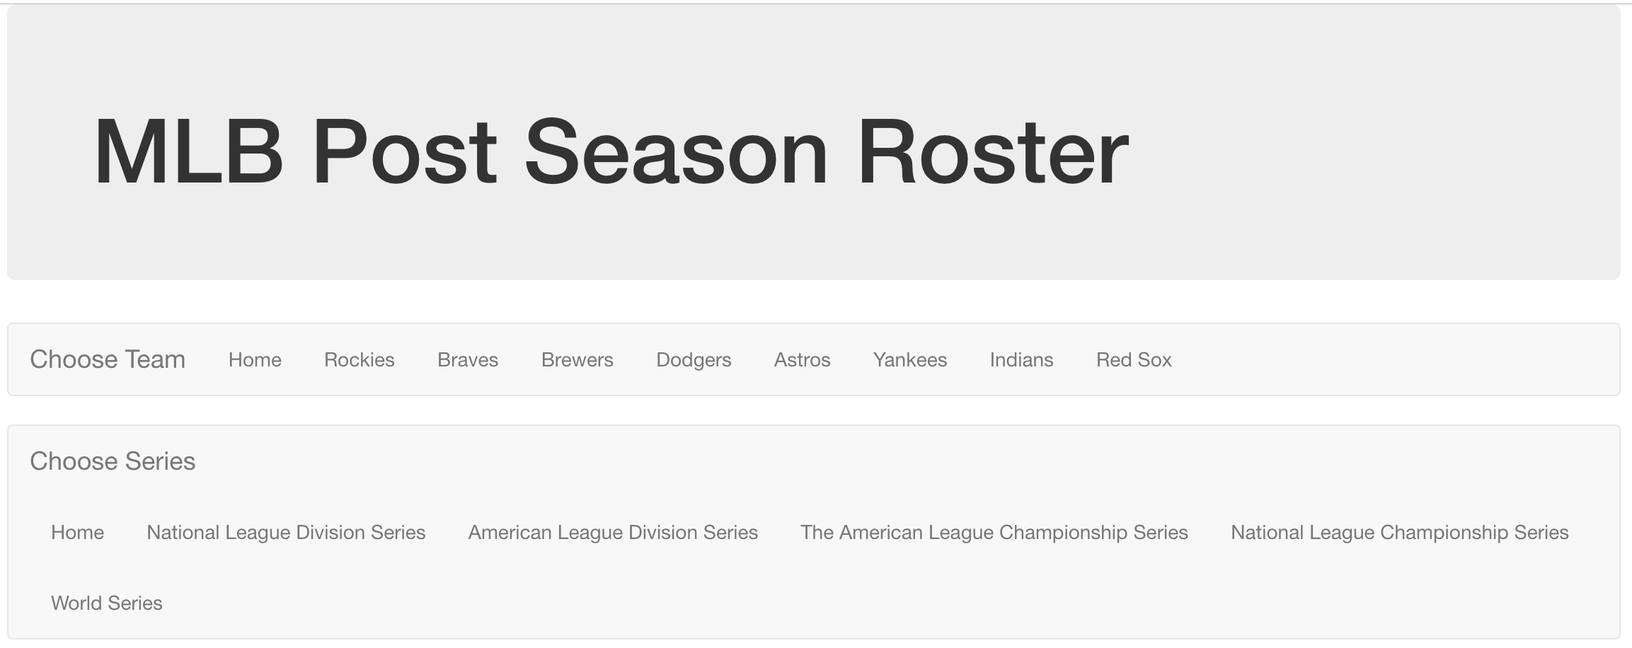
Home Screen

Slide 9
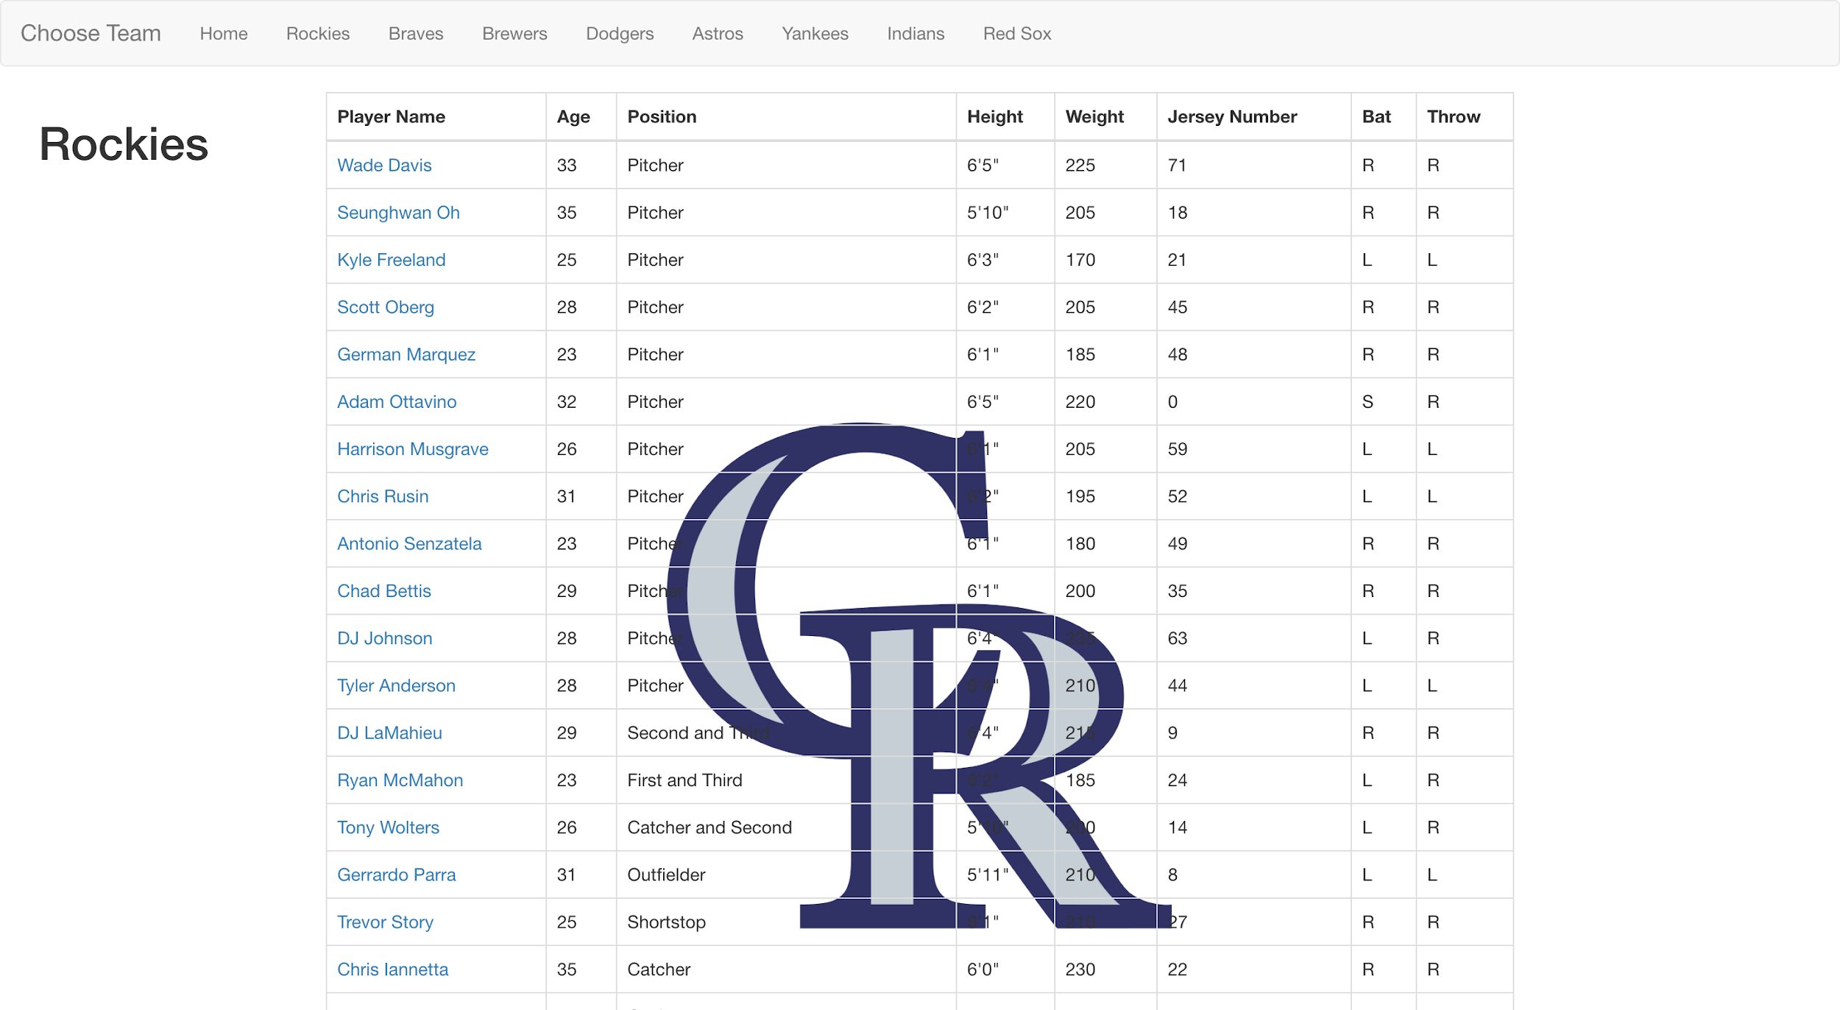
Team Pages

Slide 10
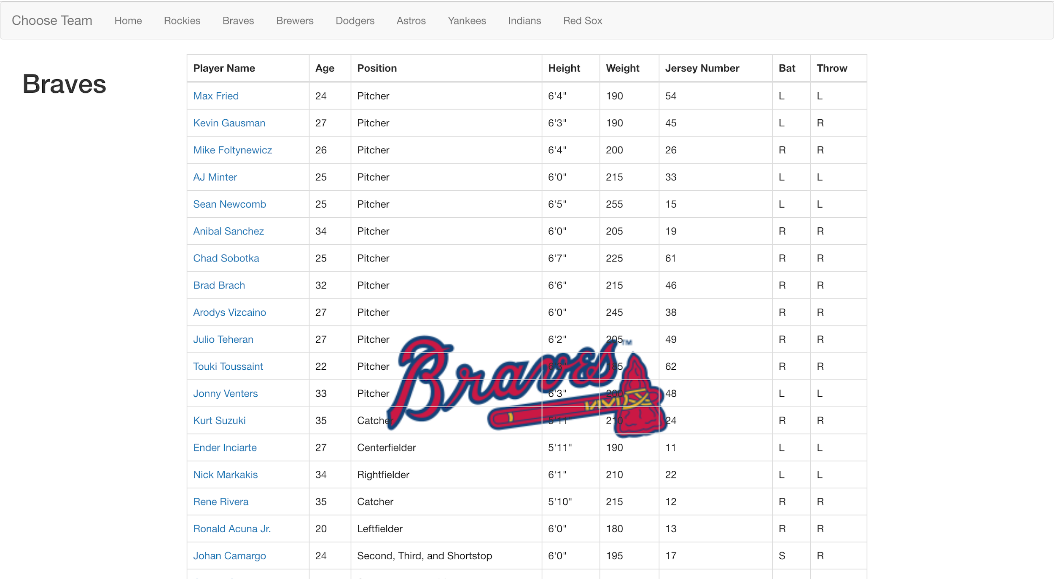
Team Pages

Slide 11
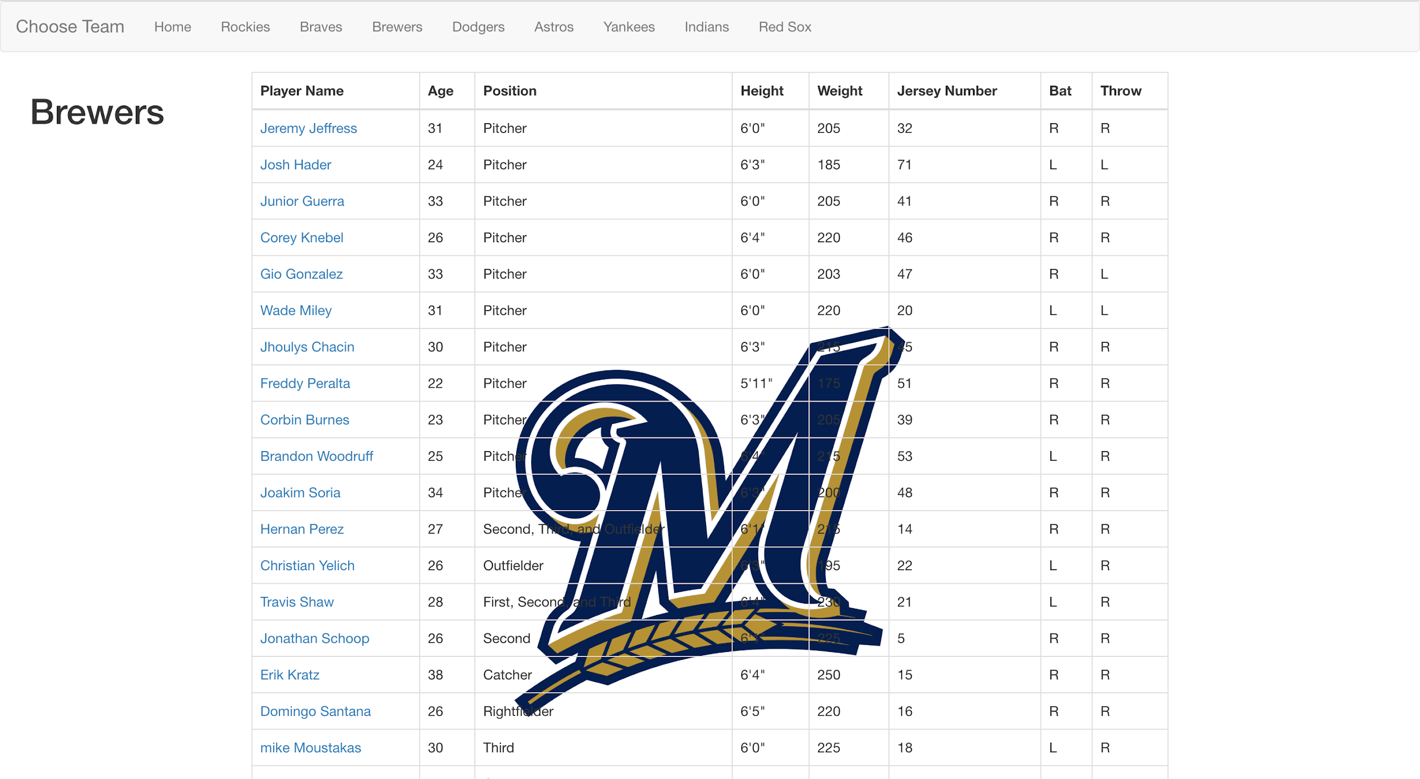
Team Pages

Slide 12
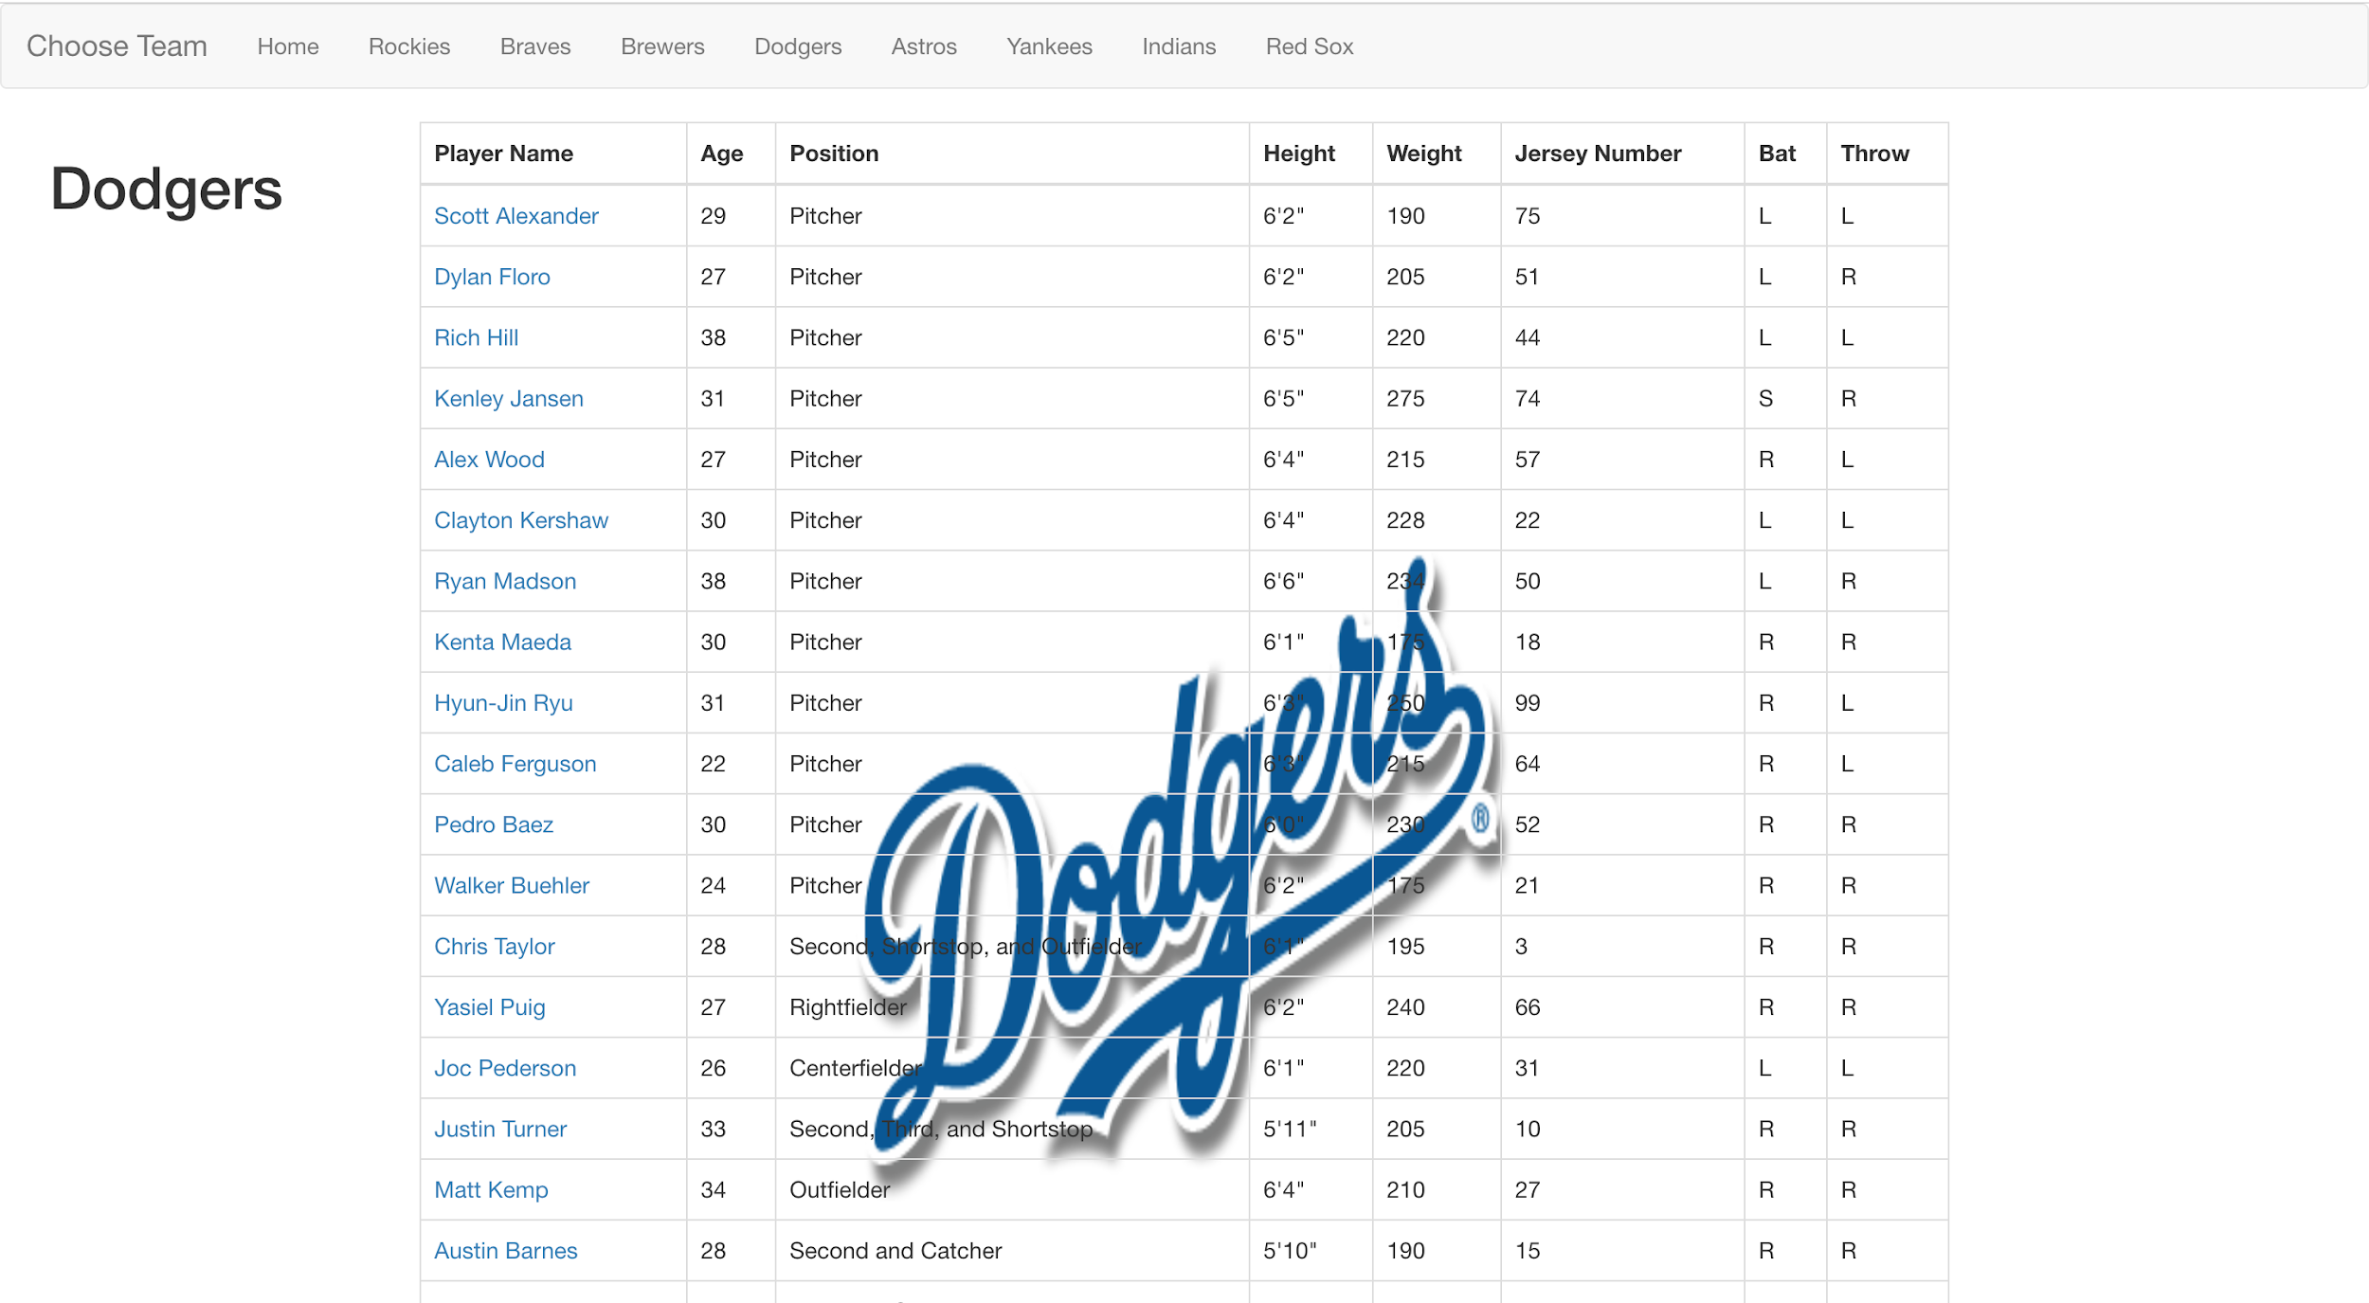
Team Pages

Slide 13
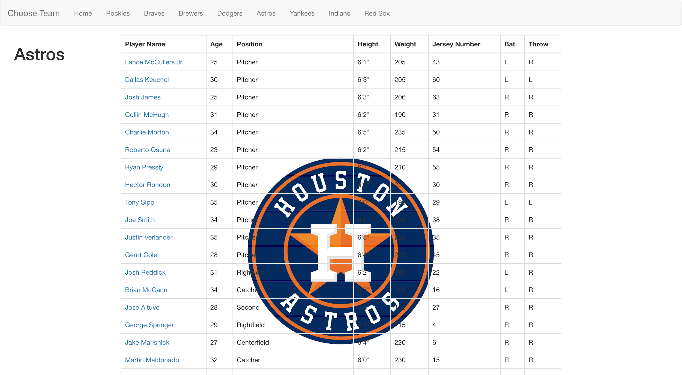
Team Pages

Slide 14
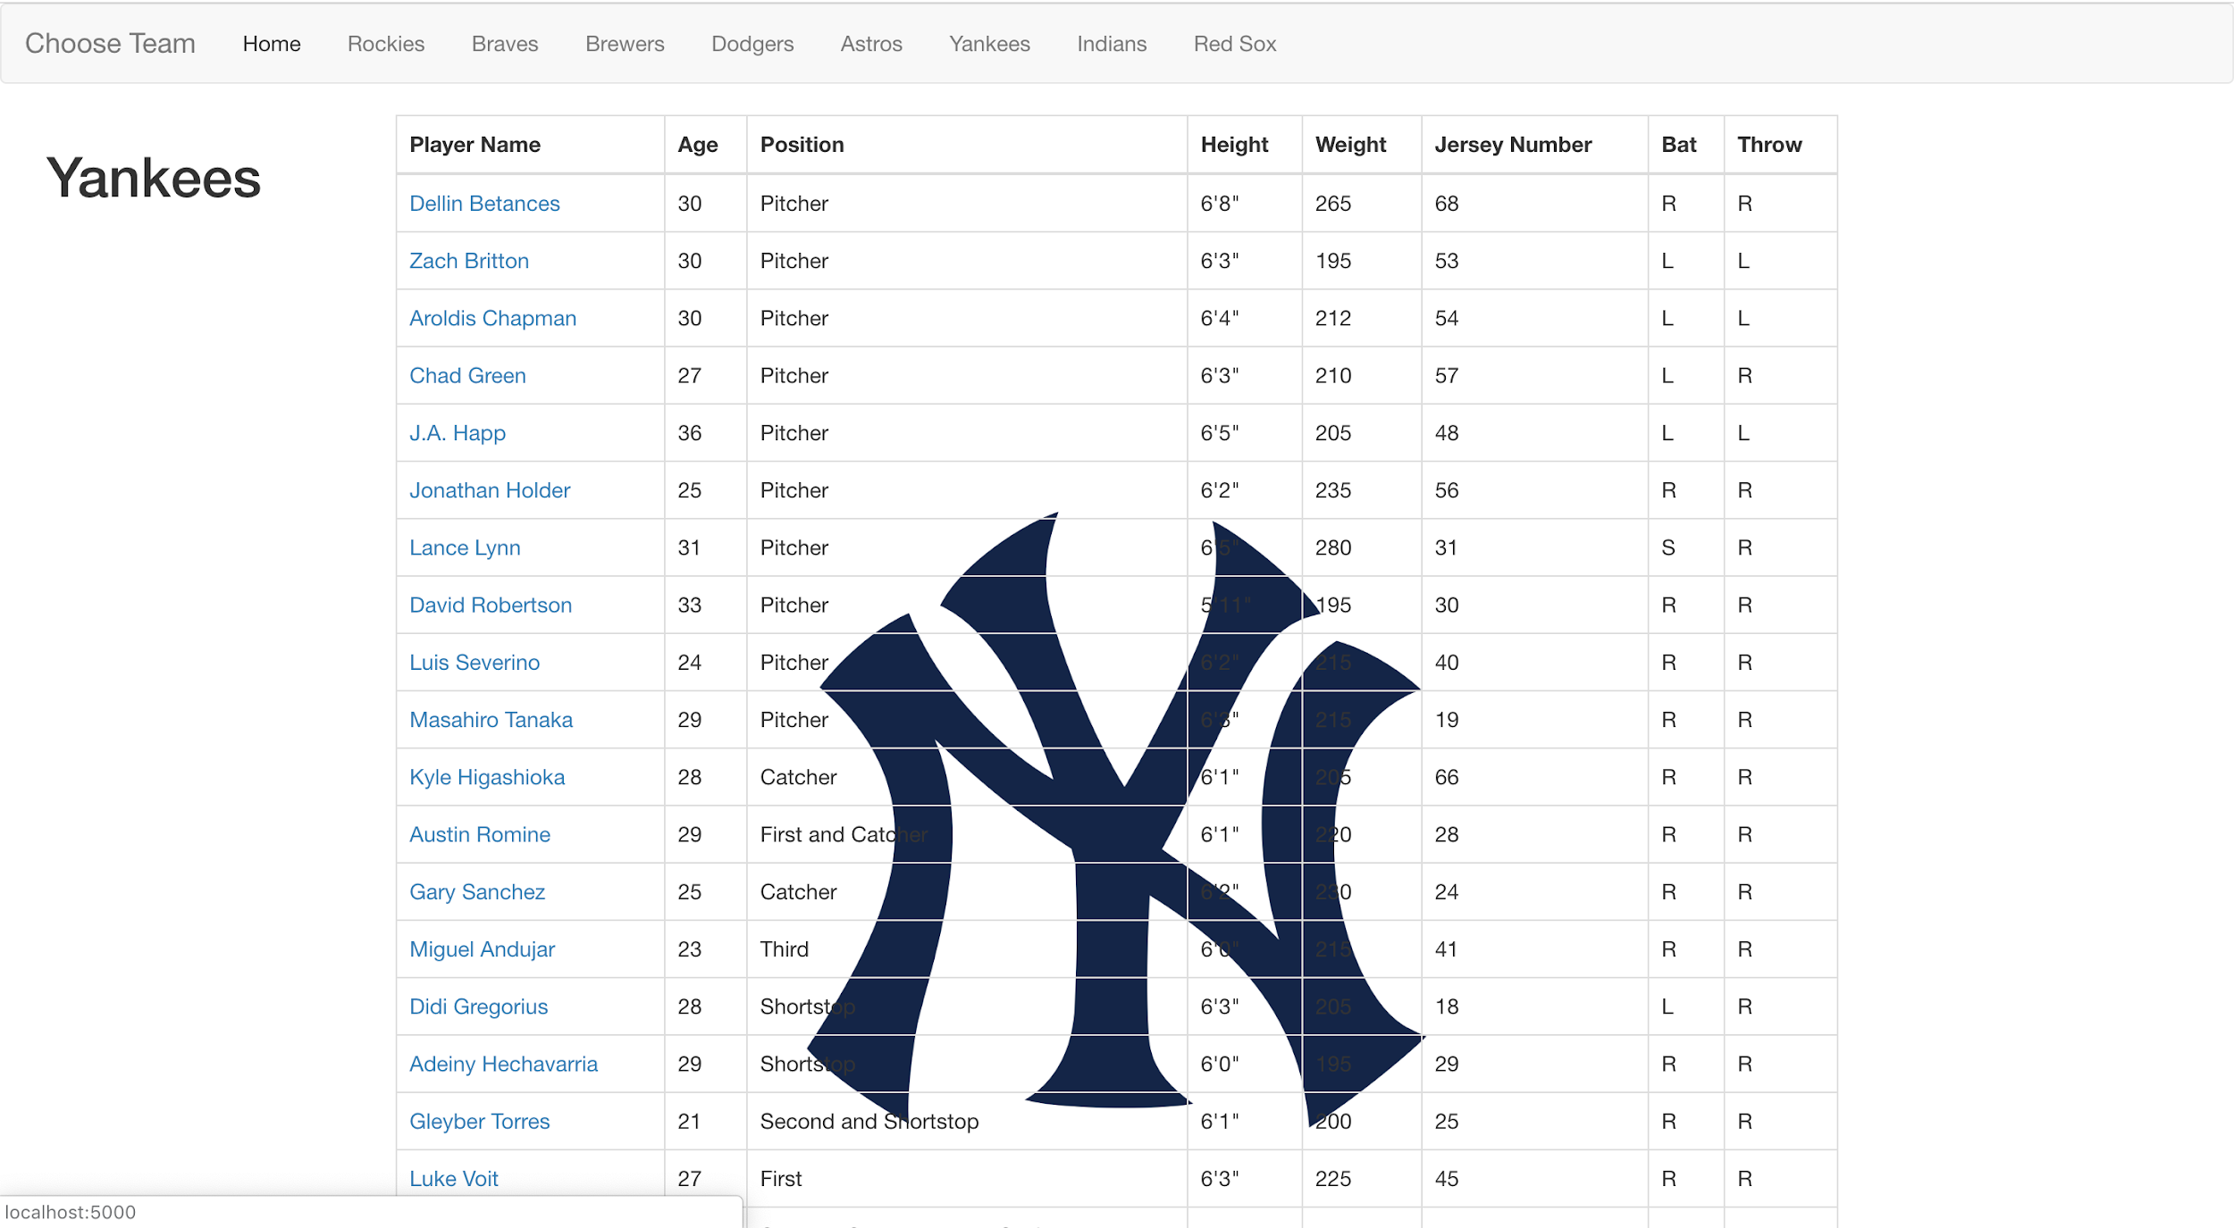
Team Pages

Slide 15
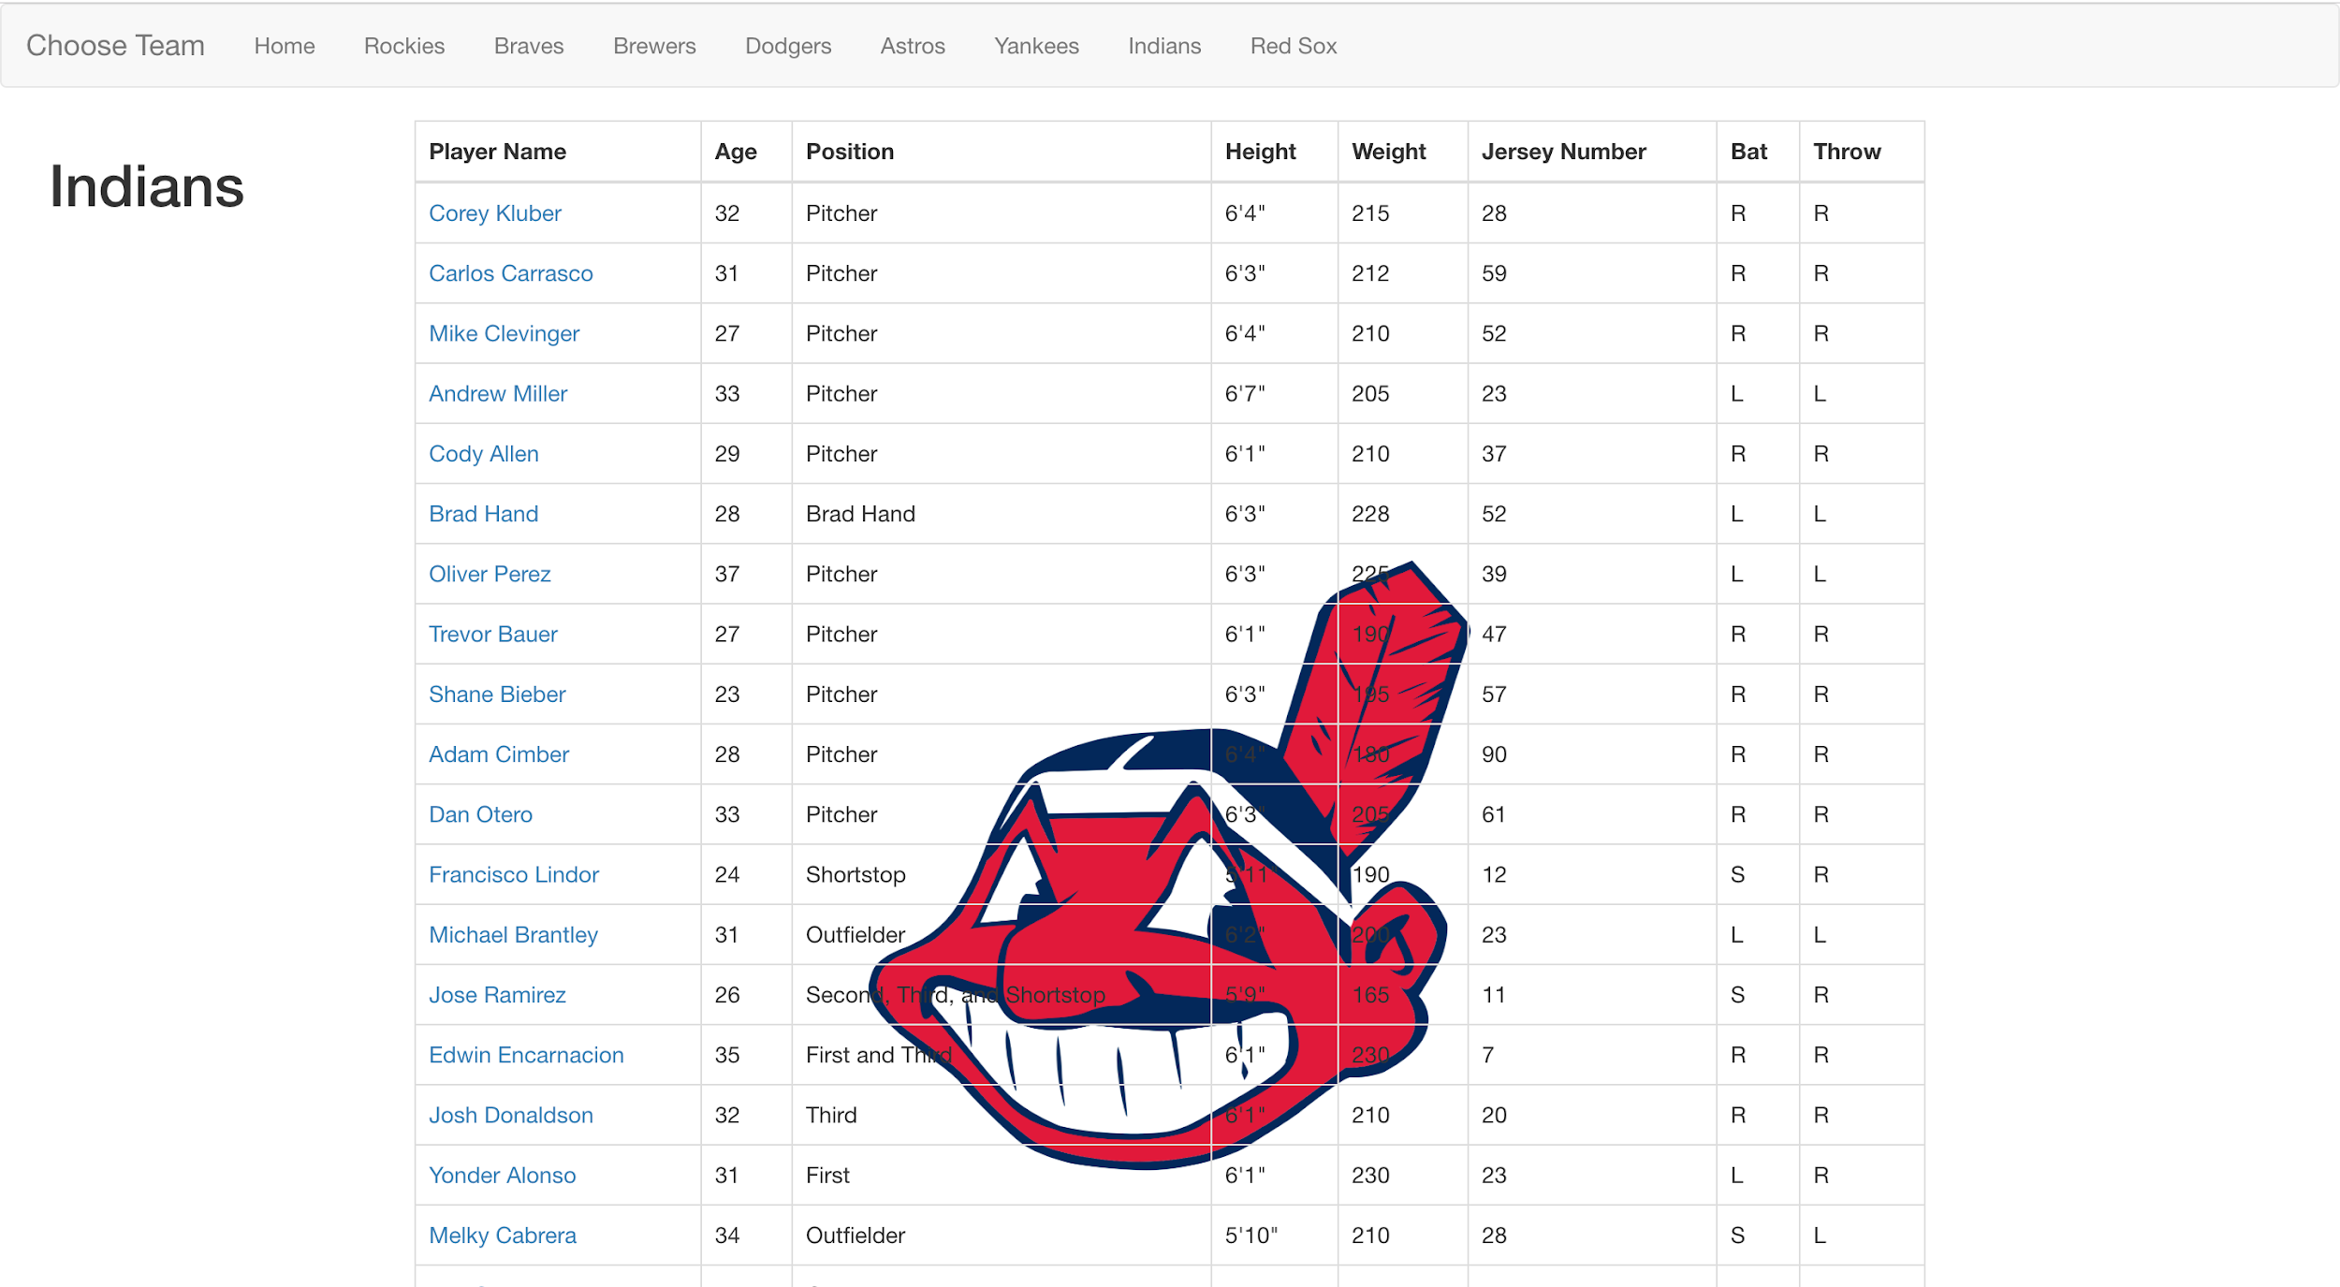
Team Pages

Slide 16
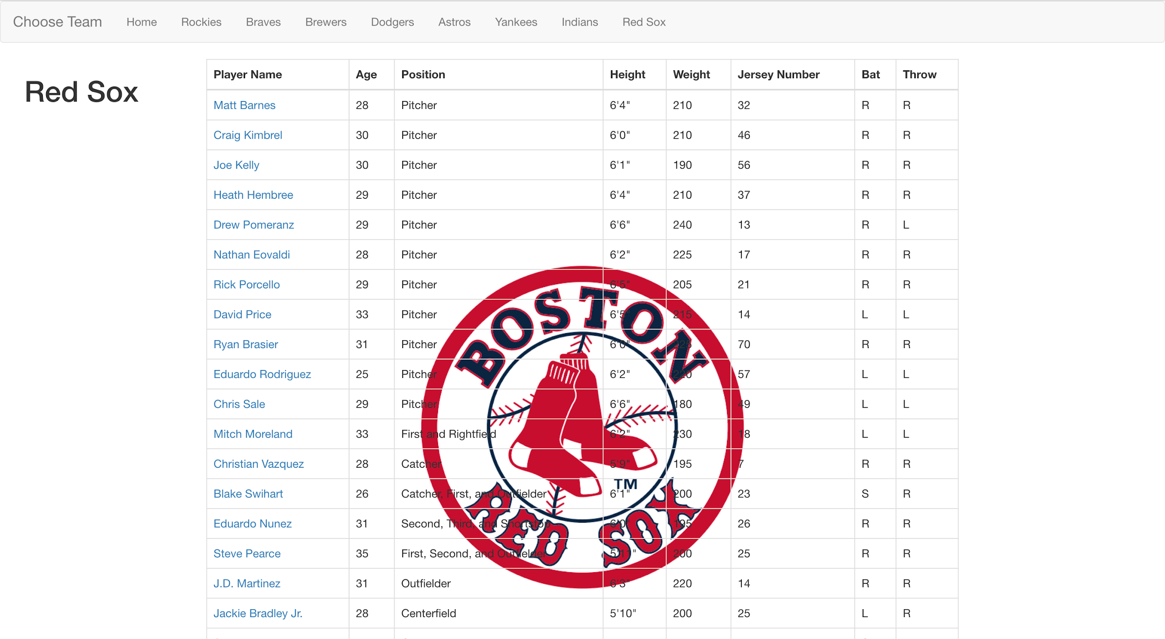
Team Pages

Slide 17
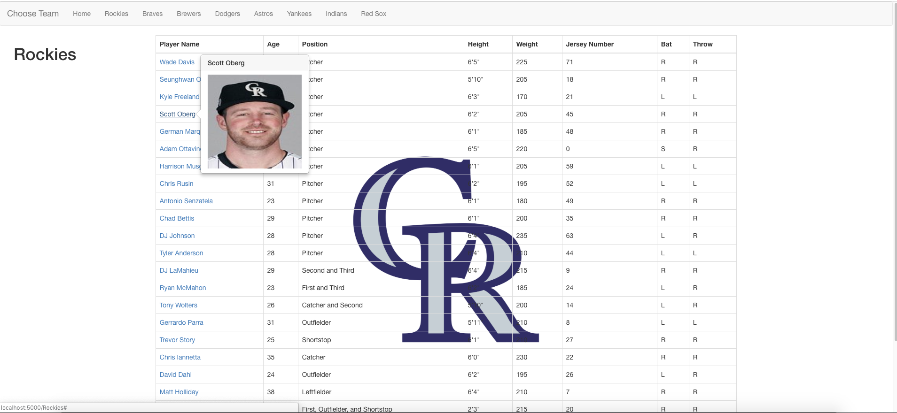
Player Image Popup

Slide 18
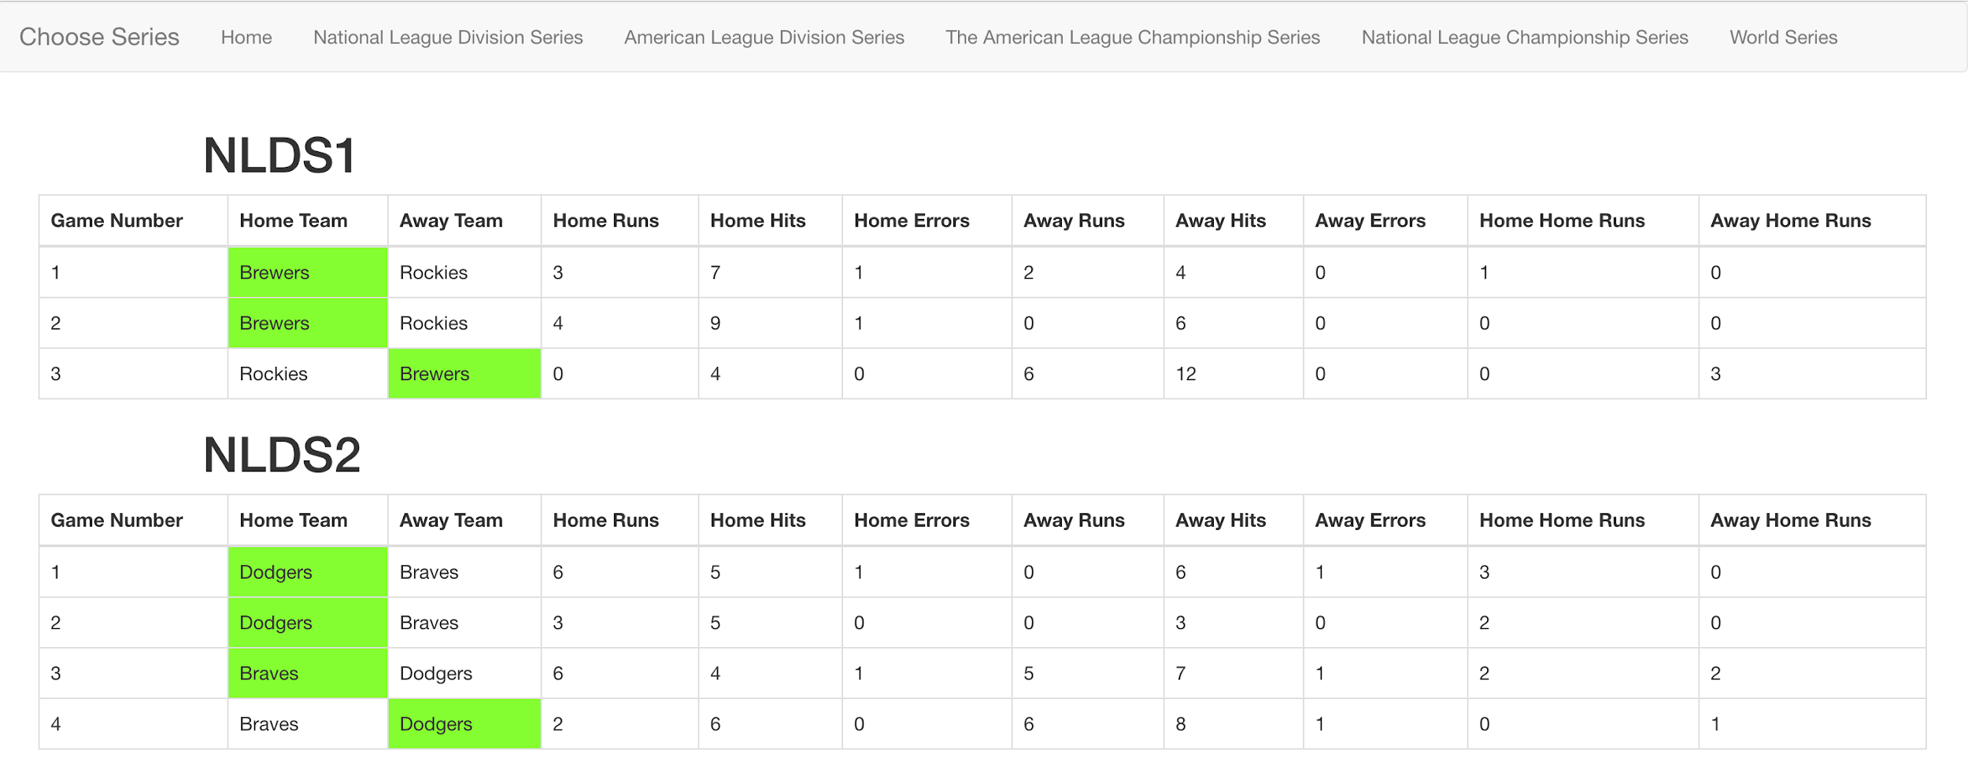
Game Series Pages

Slide 19
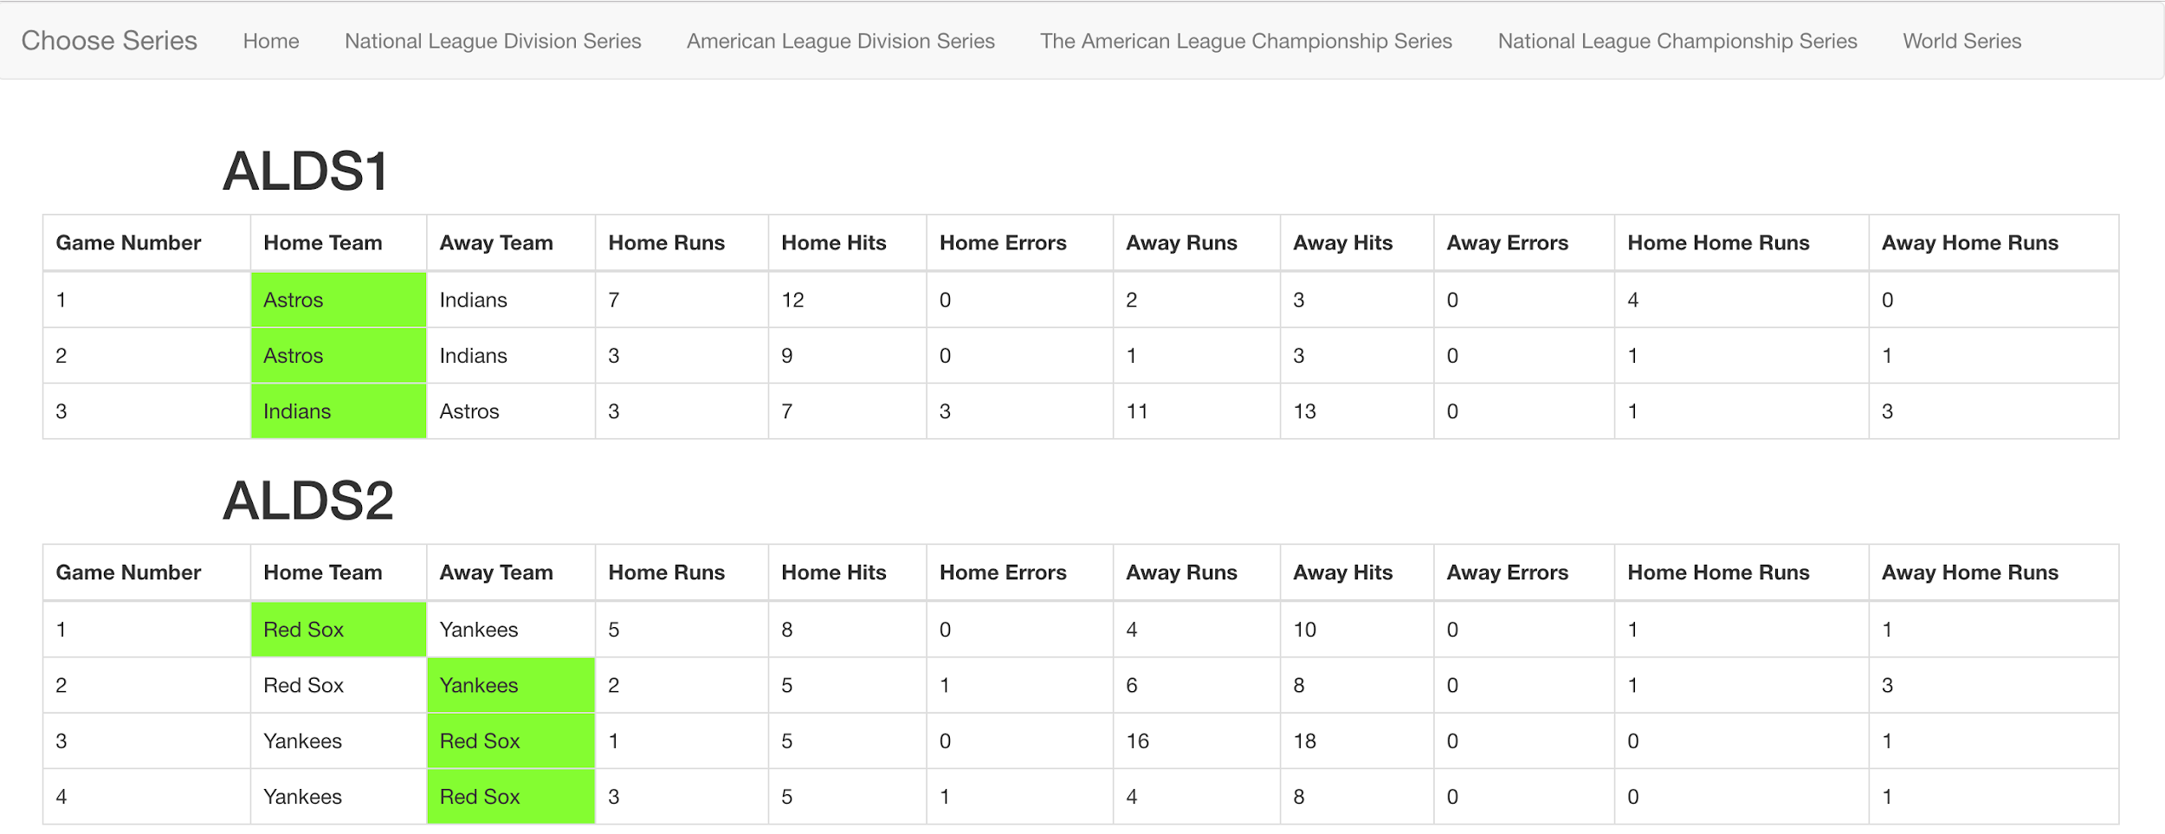
Game Series Pages

Slide 20
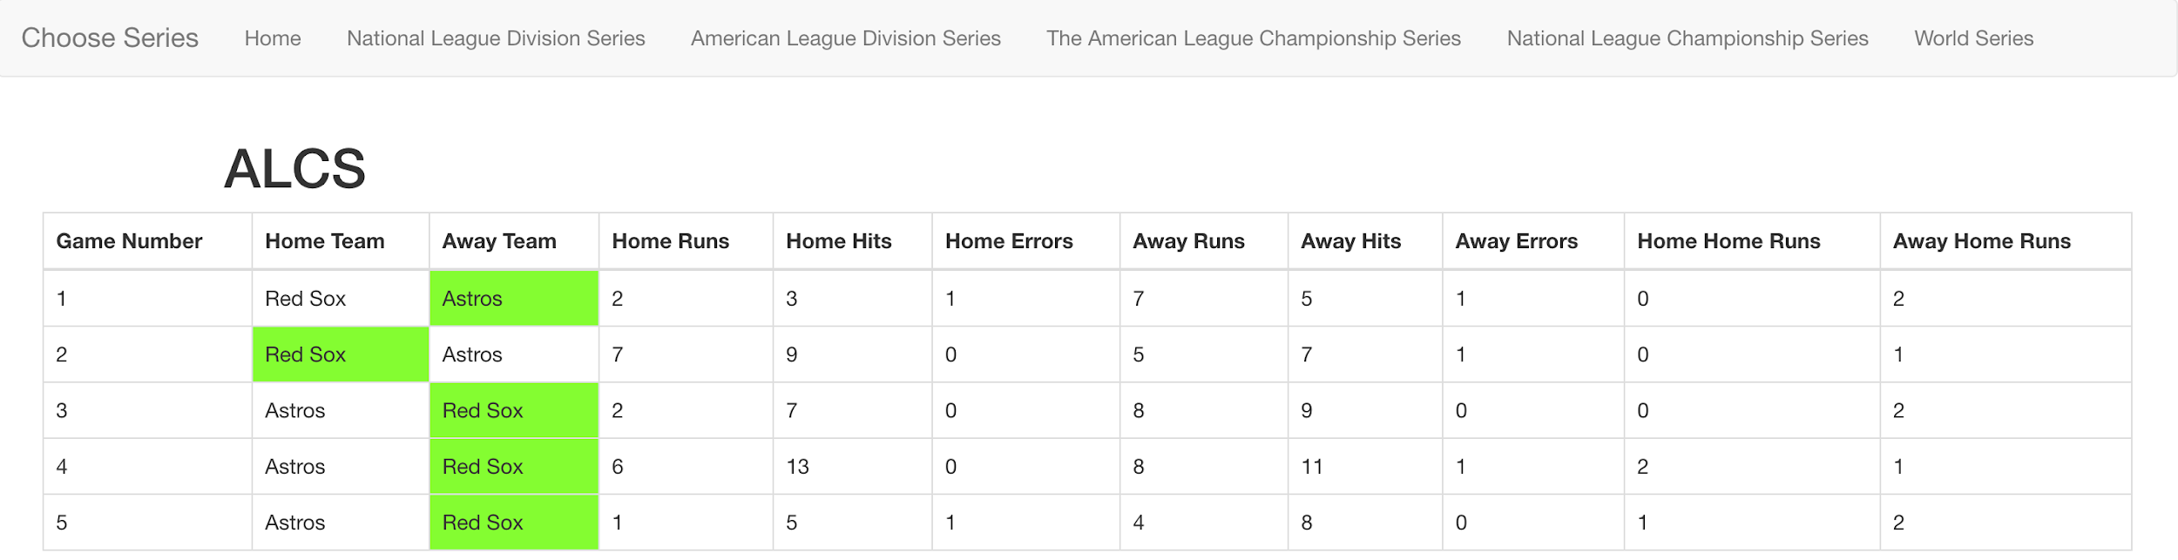
Game Series Pages

Slide 21
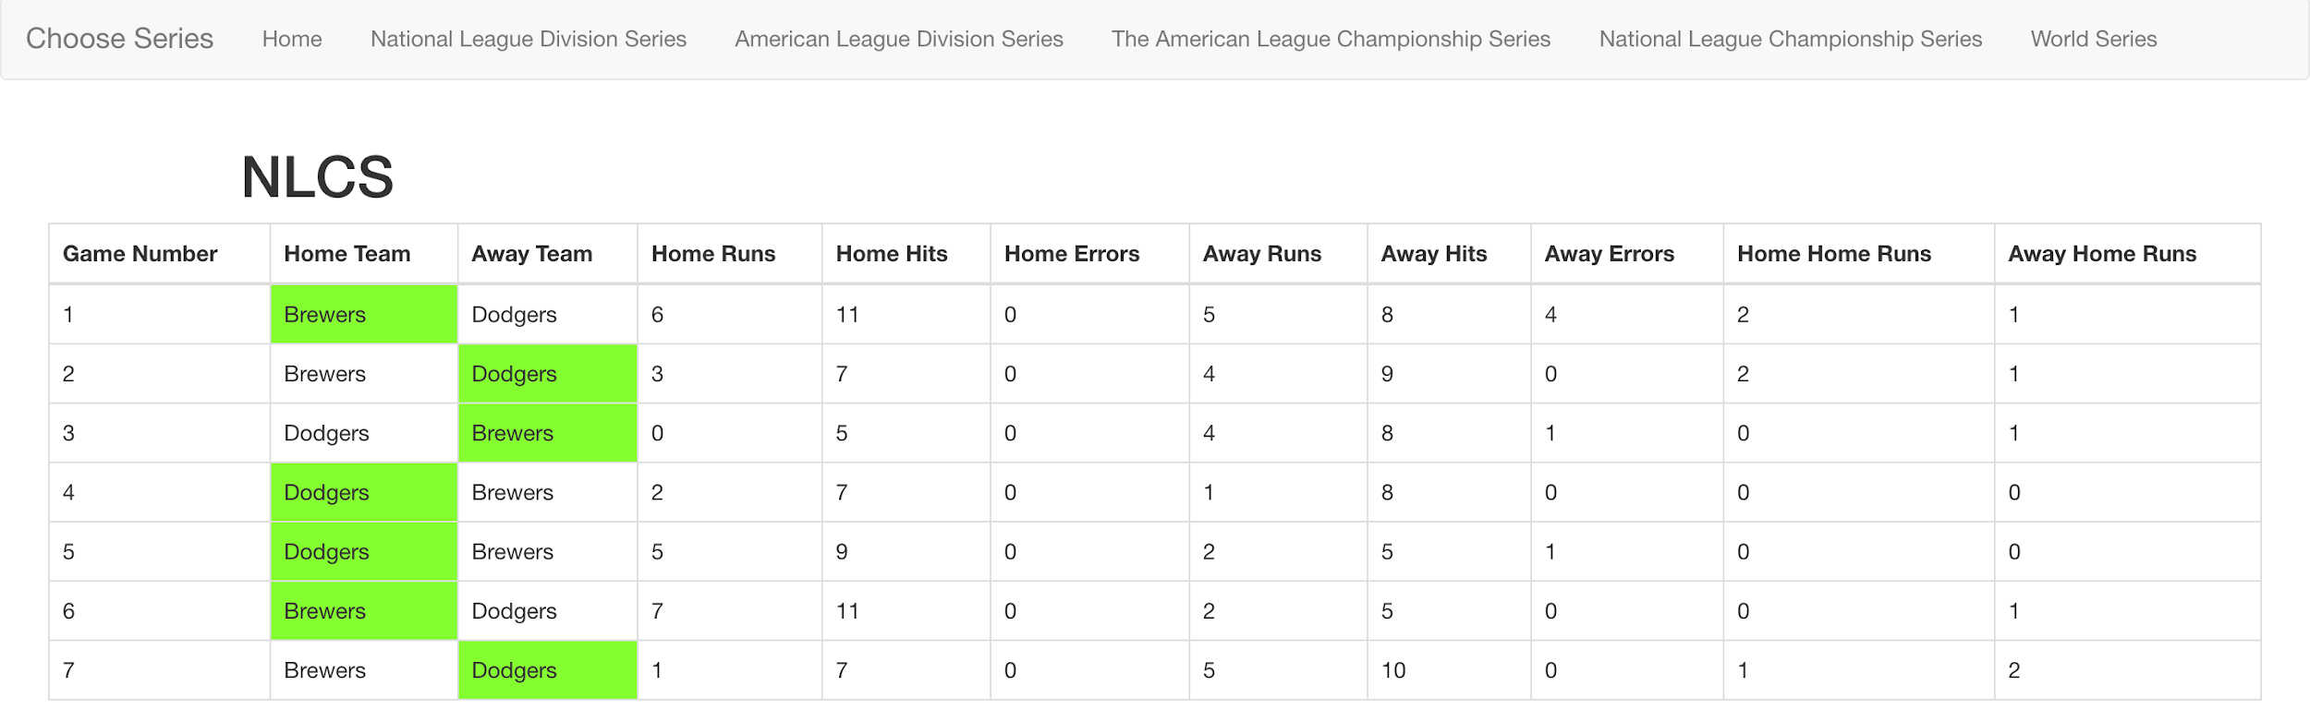
Game Series Pages

Slide 22
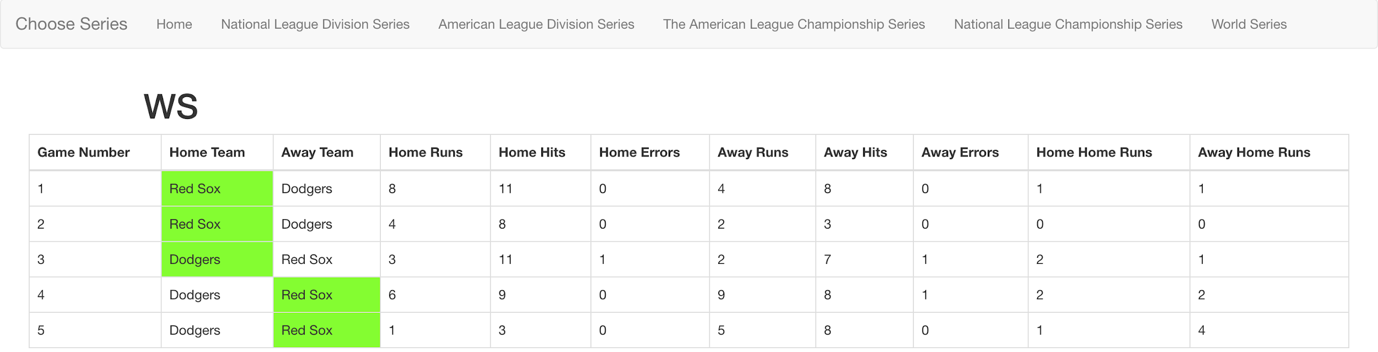
Game Series Pages

